Slide 1
Variables and Expressions
Chang (rev. 2015-02-05)

Slide 2
Variables
Variables are names of places that store information.
Making variables in Python:
someVariable = 10
someVariable is a variable.
someVariable has value 10.
someVariable can have a diffèrent value lator.
The = is called the assignment operator.
It allows you to change the value of a variable.

Slide 3
Variables
The right hand side of the assignment can be any mathematical expression.
someVariable = 10
anotherVariable = 5 + 9
aThirdVariable = 10 * anotherVariable
someVariable = someVariable + anotherVariable
Whenever a variable is on the right hand side of an expression, it is actually replacing the value of the variable at left hand size..

Slide 4
Types
There are many different types of values !
Numbers (integer or floating point)
True / False values (called booleans)
Strings (collections of characters)
aString = ‘Hello everyone’
x = 1.12
bool = True

Slide 5
Rules for Naming Variables
Variable names are case sensitive. Hello is different from hello.
Should not start with a number.
Cannot be any other python keyword (if, while, def, etc).
Always give your variables meaningful names!

Slide 6
Output
We’d like to see what’s stored in our variables!
Python can print things for us:
print("Hello world")
You can also output the contents of variables:
someVariable = 10
print(someVariable)
You can even do combinations!
print("Your variable is ", someVariable)

Slide 7
Exercise
What will the following code snippet print?
a = 10
b = a * 5
c = "Your result is: "
print(c, b)
Your result is:50

Slide 8
Exercise
What will the following code snippet print?
a = 10
b = a
a = 3
print(b)
It will print out 10. When you set one variable equal to another, they don’t become linked; b is set to 10 and no longer has anything else to do with a.

Slide 9
# initialize variable 1
var1 = 1
# initialize 2nd variable
var2 = 'string-2'
# initialize 3rd variable v
ar3 = float(23.42)
print(var1, var2, var3)
1 string-2 23.42

Slide 10
Input
Sometimes, we’d like the user to participate! We can also get input from the user.
userInput = input("Please enter a number ")
print(userInput)
The output will look like this:
Please enter a number 10
10

Slide 11
Input
This line:
userInput = input("Please enter a number")
Takes whatever the user entered and stores it in the variable named "userInput"
You can do this as many times as you like!
userInput1 = input("Enter first number.")
userInput2 = input("Enter second number.")

Slide 12
Input
Note: All input values are strings.
a = "10"
b = 10
Variables a and b are different.
To turn an input into a number:
IntegerInput = int/float(input("Enter a number: "))
int stands for integer

Slide 13
Exercise
Pretend you’re writing a program to compute someone’s weighted grade. You have so far:
hwWeight = 0.4
examWeight = 0.5
discussionWeight = 0.1
Write a program starting with these three lines that asks the user for their homework grade, exam grades, and discussion grades and prints out their total grade in the class.

Slide 14
How an assignment is executed
Evaluate the right-hand side to a value
Store that value in the variable
x = 2
print x
y = x
print y
z = x + 1
print z
x = 5
print x
print y
print z
State of the computer:
Printed output:
2
2
3
5
2
3
x: 2
x: 5
y: 2
z: 3

Slide 15
Which of the following examples are correct?
500 = numStudents
numStudents = 500
numCookies * cookiePrice = total
mpg = miles_driven / gallons_used
"Hello World!" = message
_CMSC201_does_ = "Very learning"
60 * hours = days * 24 * 60
1/3/5/7 are right
?????

Slide 16
In Python, all data has an associated data “Type”.
You can find the “Type” of any piece of data by using the type() function:
type( “Hi!”) produces <type 'str'>
type( True ) produces <type 'bool'>
type( 5) produces <type 'int'>
type(5.0) produces <type 'float'>
print(type(123)) ???
print(type(“Ashish”)) ???

Slide 17
Data can sometimes be converted from one type to another. For example, the string “3.0” is equivalent to the floating point number 3.0, which is equivalent to the integer number 3
Functions exist which will take data in one type and return data in another type.
int() - Converts compatible data into an integer. This function will truncate floating point numbers
float() - Converts compatible data into a float.
str() - Converts compatible data into a string.
Examples:
int(3.3)
str(3.3)
float(3)
float(“3.5”)
int(“7”)
int(“7.1”)
float(“Test”)

Slide 18
int(3.3) produces 3
float(3) produces 3.0
int(“7”) produces 7
str(3.3) produces “3.3”
float(“3.5”)produces 3.5
int(“7.1”) throws an ERROR!
float(“Test”) throws an ERROR!

Slide 19
Python Keywords
Keywords are the reserved words in Python.
keywords are not used as a variable name, function name or any other identifier. They are used to define the syntax and structure of the Python language.
There are more than thirty(30) keywords identified in Python 3.7. This number may from time to time.

Slide 20
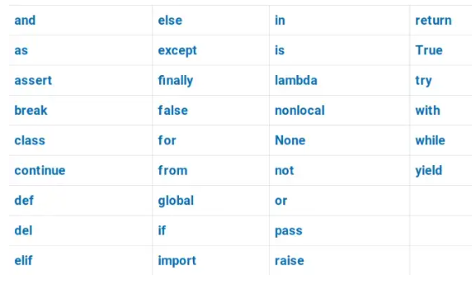

Slide 21
Python Identifiers
An identifier is a name given to entities like class, functions, variables, etc.
Identifiers helps to differentiate one entity from another.
Rules for writing identifiers
It can be a combination of letters in lowercase (a to z) or uppercase (A to Z) or digits (0 to 9).
It can be an underscore _.
myCar, str_1, var_23
multiple words can be separated using an underscore, like this_is_a_sentence.
An identifier cannot start with a digit. 1variable is invalid, but variable1 is a valid name.
Keywords cannot be used as identifiers.
example : global = 40
special symbols like !, @, #, $, % etc. cant not used as identifiers
identifier size can be of any length
Note : Python is a case-sensitive language. Example : Variable and variable are not the same.

